Slide 1
AIOPS4B
UK Tech Talks 2021
AI-led business operations & decision making
18/11/2021

Slide 2


INTRODUCTION
The purpose of the session is:
Overview the current business decision making practices and challenges
What is AIOps4B (AI-led business operations and decision making)? And how it might help to solve the operational business decision making challenges?
What are the AIOps4B technical details?

Slide 3

AGENDA
1) Current state in business operations decision making and challenges – 5 mins
2) What is AIOps4B and how to solve challenges with AIOps4B? - 10 mins
3) AIOps4B Architecture and deep dive – 15 mins
4) Q / A – 15 mins

Slide 4








1. Business Decision making – Current state
The traditional business decision making can be automated with explainable decision making processes to reduce time to insight, and costs (saving analysts making drill-down queries, developing analytics solutions, and DWH costs)
Most organizations use static KPI dashboards to monitor operational objectives and drill-down for root-cause analysis to explore why things went wrong.
For example, businesses may ask questions such as “What is the root-cause of low Revenue (KPI) ?” and the analysts perform manual drill-down queries on DWH.
Also, there will be several other questions that is not easy to answer with quick drill-down queries, such as: “Which customers are more likely to upgrade for the new product launch?”
Traditional business decision making is manual process and “time-to-decision” is high.
Modern Data Platforms
Analysis & Analytics
Point of decision making
Analysts
send results
Summarize metrics
Drill-down queries
Advanced analytics
Business users
Traditional data-driven decision making process is a non-repeatable manual process and not scalable (considering a organization needs around 100 KPI’s to run the business) that might take weeks to answer a single business question.

Slide 5
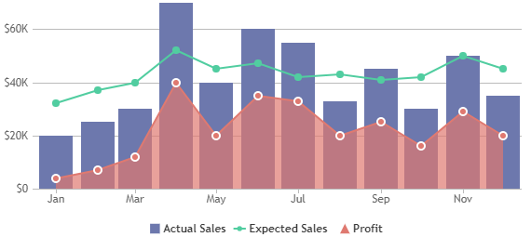
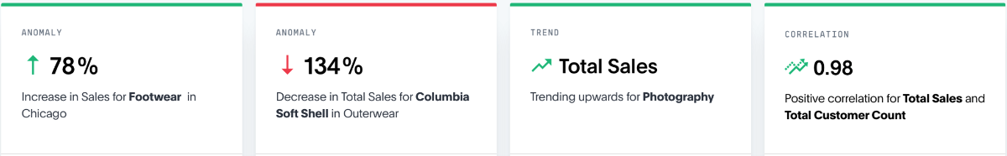
1. Business Decision making – The challenge
The vendor solutions may reduce “time-to-decision” but yet, they are generic with one size fits all approach. They may not prevent manual drill-downs and advanced analytics development altogether.
Some vendors already offer Automated Insight tools to help solve the pain points of traditional decision-making.
They do automated trend, anomaly, and correlation analysis.
But ,
They still do not explain the very root-cause of the trends with correlation analysis only.
They need to consider the internal / external events (special holidays, events, etc.) accurately to properly identify / label the trends per organization verified by analysts.
And,
After finding the root-cause, they do not provide optimized recommendations to fix the root-cause. (which usually require advanced analytics per use-case)
Revenue KPI
Trend 2
Trend 1

Slide 6
AIOps4B – AI-led business operations framework
2. Business Decision making with AIOps4B
Organizations would need a more “customizable / accurate / optimized / explainable” approach to reduce the “time-to-decision”.
Operational Business decision making challenges
Traditional approach: Manual Drill-downs / High time-to-decision.
Automated Insights (by vendors): Generic and would need customizations (per org.) to provide “accurate / optimized” business decisions.
AIOps is coined for autonomous data centers.
AIOps4B term is coined for autonomous business operations and decision making in mind.
AIOps4B initially aims to solve the decision making challenges through re-usable but customizable API’s:
Prep - Identify / Validate trends in the data by configuring / training the trend analytics model per organization
Prediction API – Predicts the future trends based on future internal and external events configured
Root Cause API – Automatically identify the root-cause of each trend using the generic logic developed (with the real impact of each metric) For e.g. the revenue went down %10 because of bad product reviews.
Advanced root-cause APIs – Explore further the root-cause with re-usable advanced analytics. For e.g. Do semantic analysis on the product reviews to realize specific issues (product quality, late deliveries, etc.)
Recommendation API – Automatically provide optimized recommended actions.
Legend:
Manual – but quick turnaround
Automated
Future scope

Slide 7
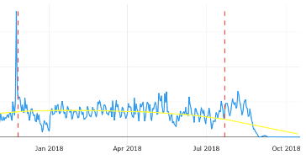
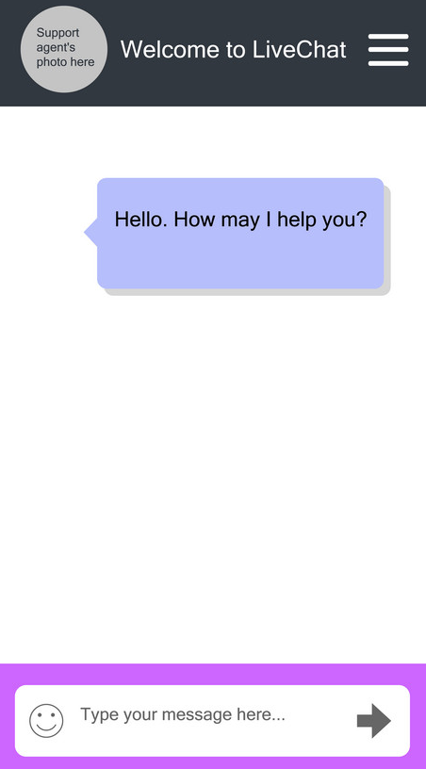
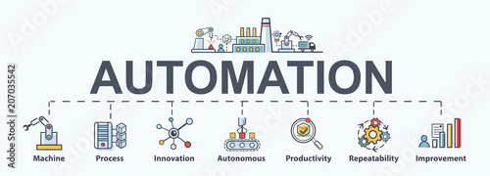

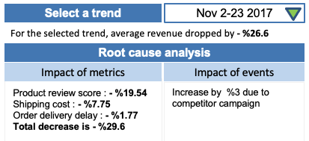
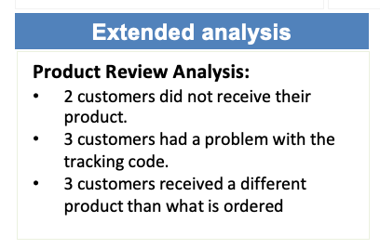
2. AIOps4B possible use cases
AIOps4B can be used for several use-cases
Business decision making
Business operations
Embed into KPI dashboards
Answer KPQ’s by stakeholders
Automated business operations
Automatically display KPI trends, explain them with root-causes without the need for manual drill-downs to DWH and advanced analytics.
Recommend actions to fix the issues (*Future scope)
Integrate with chatbots and Alexa, to respond to business questions directly, such as “Will the revenue increase %10 in the coming month?” (no longer need to develop KPI dashboards in the organization)
Automatically analyze end-to-end business processes based on targets and take optimized actions. For e.g., Autonomously manage an e-commerce site’s end-to-end order-to-cash business process
Existing KPI dashboard
Monthly Revenue
£80,000
Actual
£100,000
Budgeted
Extend dashboards with AIOps4B
Automated trend analysis
Past trend 1
Past trend 2
Future trend

Slide 8
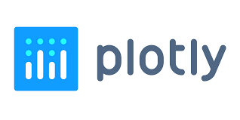

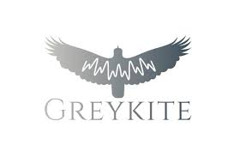

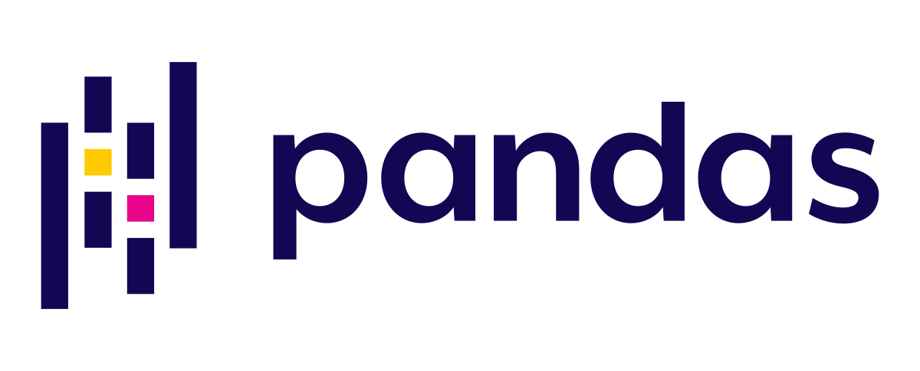

3. AIOps4B – High level architecture (prototype)
Azure AppService
The prototype can be accessed from
https://aiops4b.azurewebsites.net
DASH APPLICATION
AIOps4B - Plotly app
API
Prediction
Analyse past trends, predict future trends
Root-cause
Identifies the impact of correlated metrics
Recommendation TBD
Product Semantic Analysis Analyses product reviews
Geolocation Analysis
Trend analysis
metrics
Data cleansing and Feature engineering
Feature importance
Linear regression
Metrics
creation
Local file CSV file
Brazilian E-Commerce Public Dataset
Legend
Data pipeline
Application
Generic API
Specialized reusable API’s
External Systems

Slide 9
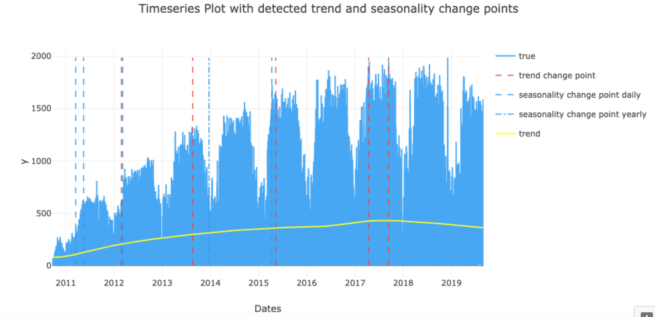
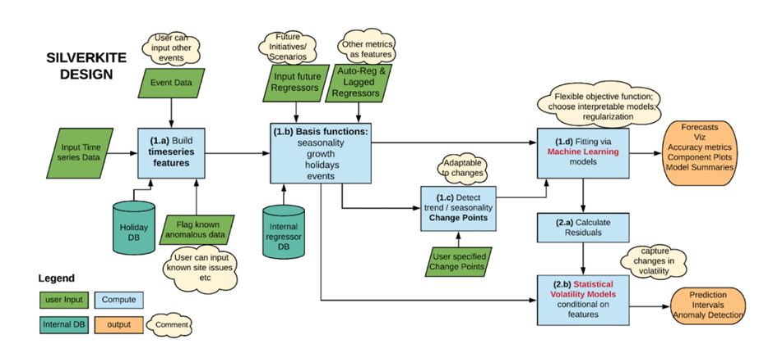

3. AIOps4B – Trend analysis deep dive
Silverkite is Greykite’s algorithm for forecasting. It is the most advanced time series analysis library!
Trend 2
Trend 3
Trend 1
A sample trend analysis
The Greykite library is an open source Python library developed by LinkedIn. It is based around Silverkite, its forecasting algorithm is highly customizable, and allows visualizations of the trend, seasonality, and other effects.
Silver kite architecture
Some key benefits of the Silverkite algorithm:
Flexible
Intuitive
Fast

Slide 10
THE TEAM
Cengiz Kayay
Julian Gonzalez Galvez

Slide 11
Q / A

Slide 12
THANKS

